Slide 1
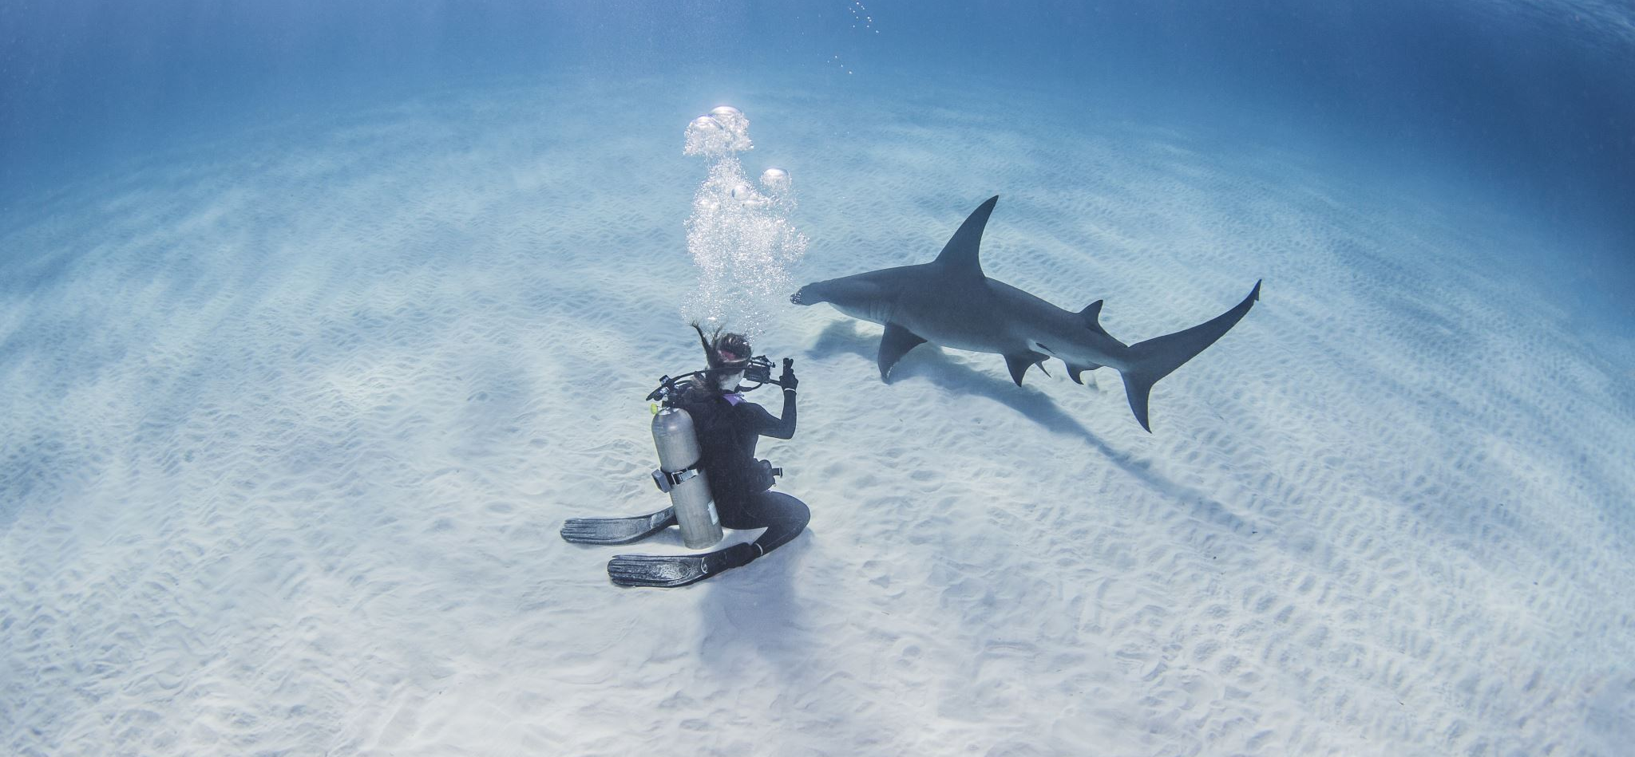
Bluefin Prosthetics: Adaptive solutions for coastal survivors
Presented by:
Rahala Moindze
Edosa Erhunmwunse
Anas Ghonaim

Slide 2
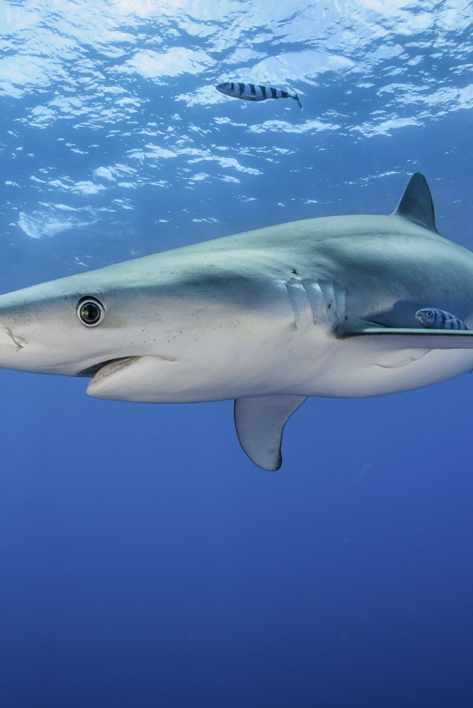
Introduction
Problem statement: The injuries experienced in coastal areas mostly lead to permanent damages to the limbs necessitating the demand for affordable prosthetics companies around.
Objective: Determine the most viable location for establishing prosthetics company.
Hypothesis: There is a high percentage of limb injuries and potential amputation in coastal areas resulting from shark attacks from year 2000 to 2025.

Slide 3
Data Wrangling and Cleaning
Deleted unwanted columns (last 11).
Standardized column names (lower case, with _).
Standardized country and state columns (all capitalized).
Filled null values for year, using median (1986).
Filtered out data from before 2000 (≈2800 rows left).
Added a column for limb injuries to analyze “injury” column and return boolean.

Slide 4
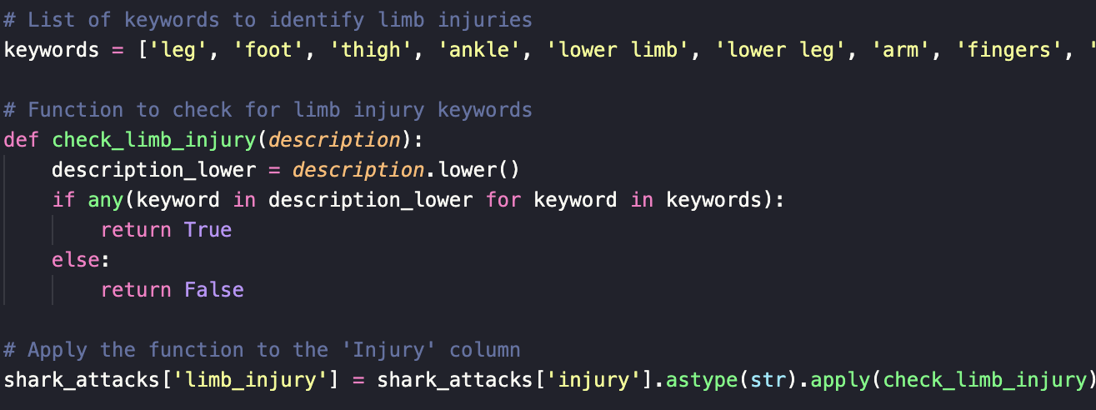
Notes:
(≈1851 limb injuries).

Slide 5
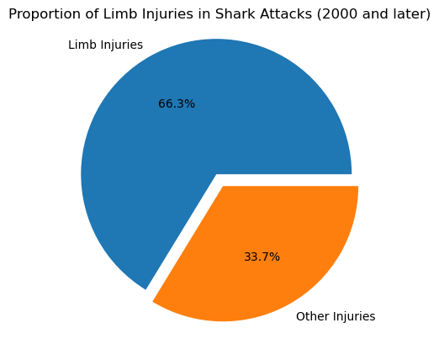

Slide 6
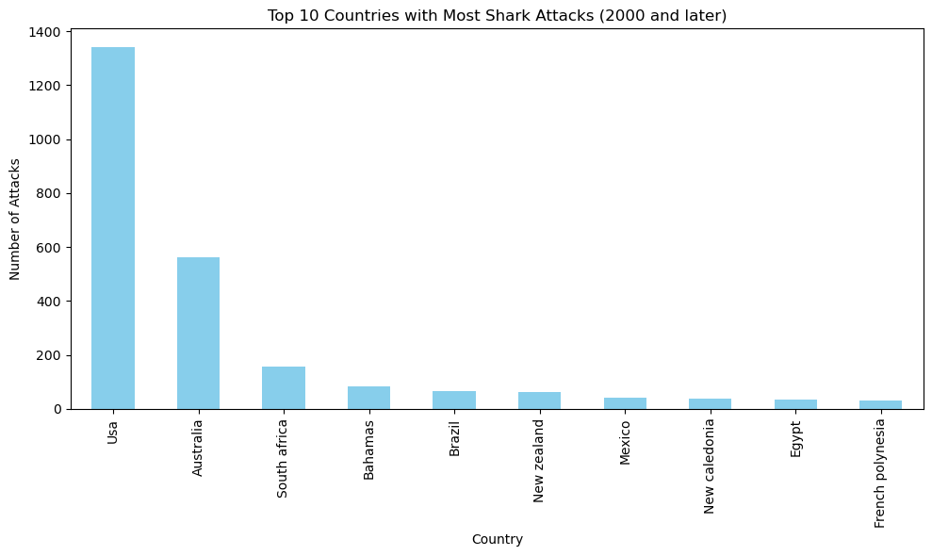

Slide 7
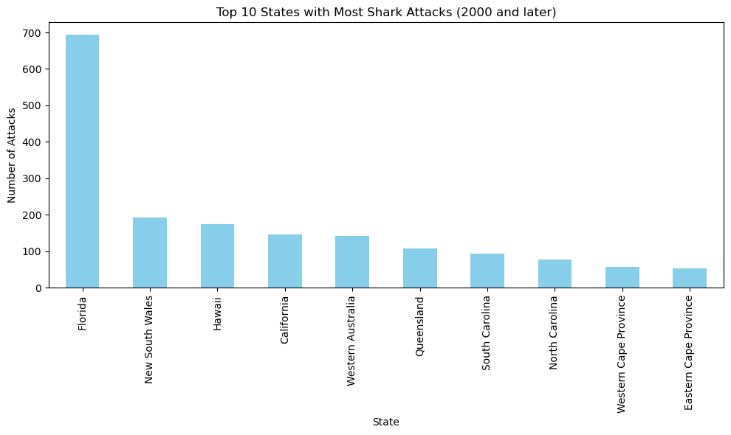

Slide 8
The business idea
Custom prosthetics line focused on shark attack survivors.
Waterproof, ocean-resistant, durable for surfing/swimming.
Features: custom designs, waterproof, with fun options (e.g., integrated GoPro mounts).
Outreach: survivor communities and surfer networks

Slide 9
Conclusion
A greater percentage of recorded shark attacks mostly affect the limbs.
Our target business location is Florida which is the highest affected state.
Expansion plans include delivering across the US and then moving to Australia.

Slide 10
Thank You & Q&A
Bluefin Prosthetics:
Rehala Moindze
Edosa Erhunmwunse
Anas Ghonaim

